Slide 1

Foodies
ENROLLMENT NO NAME OF STUDENT
1) 176620307016 PRANAV P. CHANPARA
2) 176620307029 PRATIK B. KANSARA
3) 176620307028 VANDIT D. JOSHI
4) 176620307031 RUTVIK M. KATHROTIYA
DEPARTMENT OF COMPUTER ENGINNERING
DARSHAN INSTITUTE OF ENGINEERING & TECHNOLOGY FOR DIPLOMA STUDIES
Prepared by Prof. PAYAL M. BODA

Slide 2
1. PROBLEM SUMMARY
1.1 Problem Identification
The problem now a day is to order fast food you can go at particular store and stand in queue for minutes or hours. You need to go to a specific store for the food item you wish to eat and wait for order to be prepared, Also you would rarely get a discount.
1.2 Problem Solution
This website will provide all type fast food for that you can order easily. So user does not waste time in queue. And also User can order his food at his home without going to Fast food store. User can also leave comments about food and get discount.

Slide 3
2. Detail Description
Product -
  product_id : ID of product
  sku : Stock Keep Unit
  downloadable : Whether downloadable or not
  min_price : Minimum price of product
  max_price : Maximum price of product
  rating_count : Number of ratings given to product
  average_rating : Average rating of product
  total_sales : Number of sales made

Slide 4
Comment -
  comment_id : ID of comment
  comment_post_id : ID of post on which comment is made
  comment_author : Author of comment
  comment_author_email : Email of comment author
  comment_date : Date of comment
  comment_content : Content of comment
  comment_approved : Whether comment is approved or not
  comment_type : Type of comment
  comment_parent : Parent of comment

Slide 5
Product -
  product_id : ID of product
  sku : Stock Keep Unit
  downloadable : Whether downloadable or not
  min_price : Minimum price of product
  max_price : Maximum price of product
  rating_count : Number of ratings given to product
  average_rating : Average rating of product
  total_sales : Number of sales made
Category -
  category_id : ID of category
  name : Name of category
  slug : URL-friendly slug of category

Slide 6
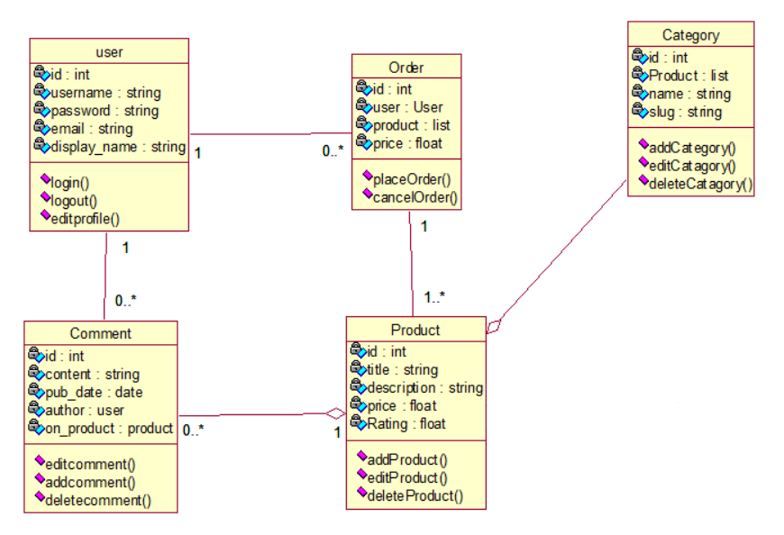
3. DIAGRAMS
3.1 Class Diagram

Slide 7
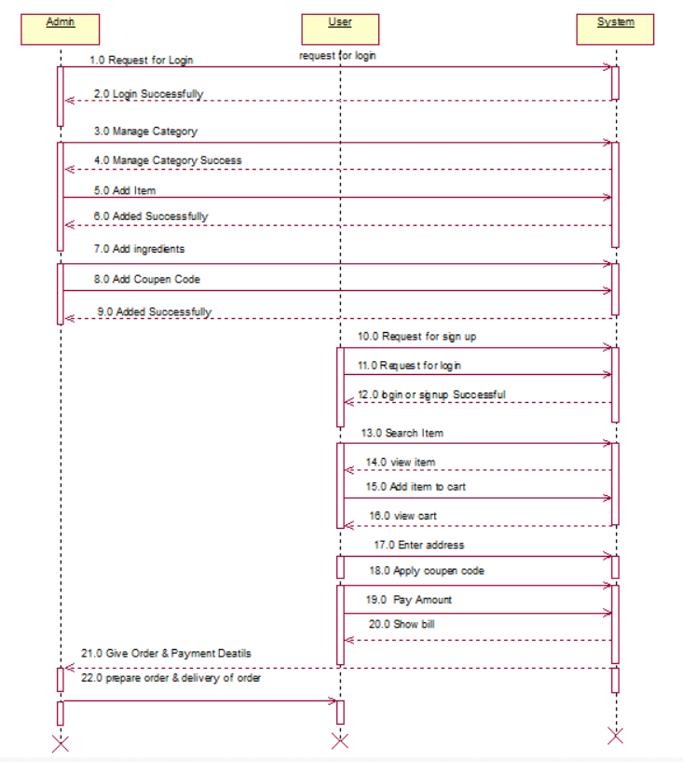
3.2 Sequence Diagram

Slide 8
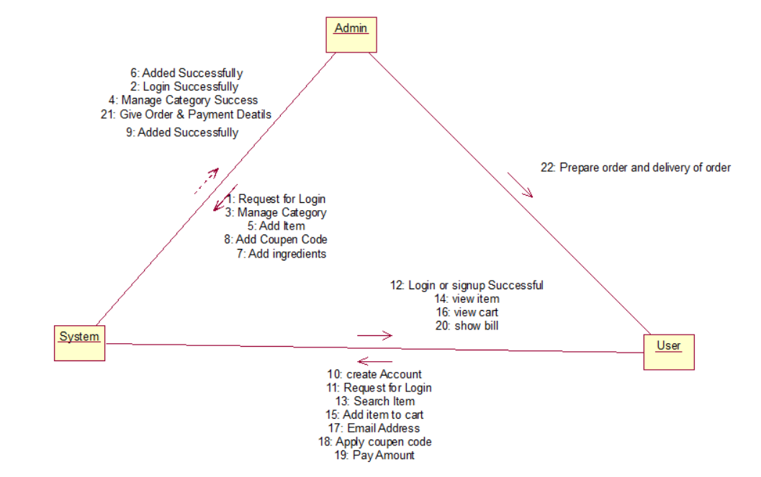
3.3 Collaboration Diagram

Slide 9
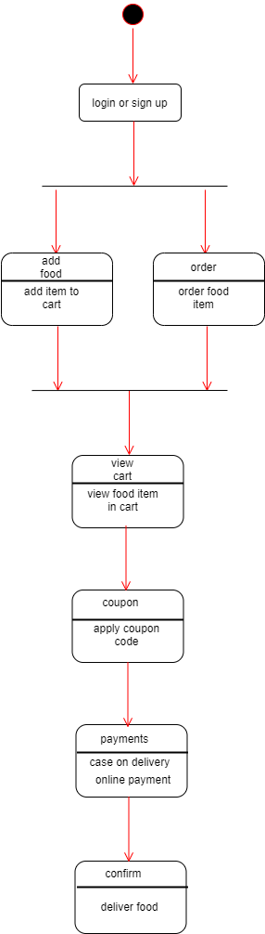
3.4 State Diagram

Slide 10
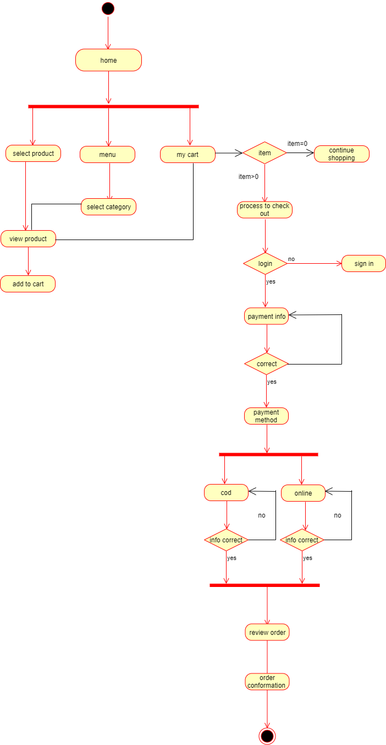
3.5 Activity Diagram

Slide 11
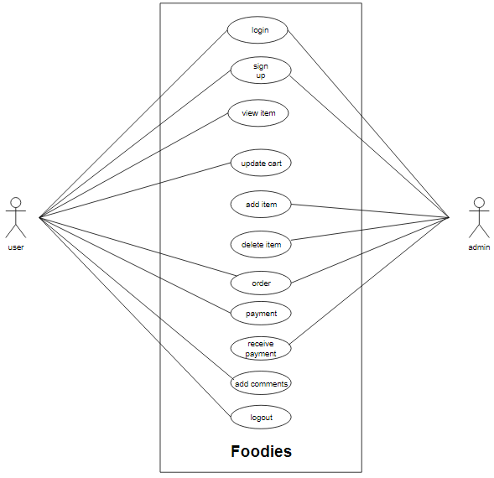
3.6 Use Case Diagram

Slide 12
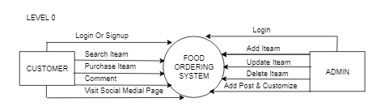
3.7.1 Data Flow Diagram(Level 0)

Slide 13
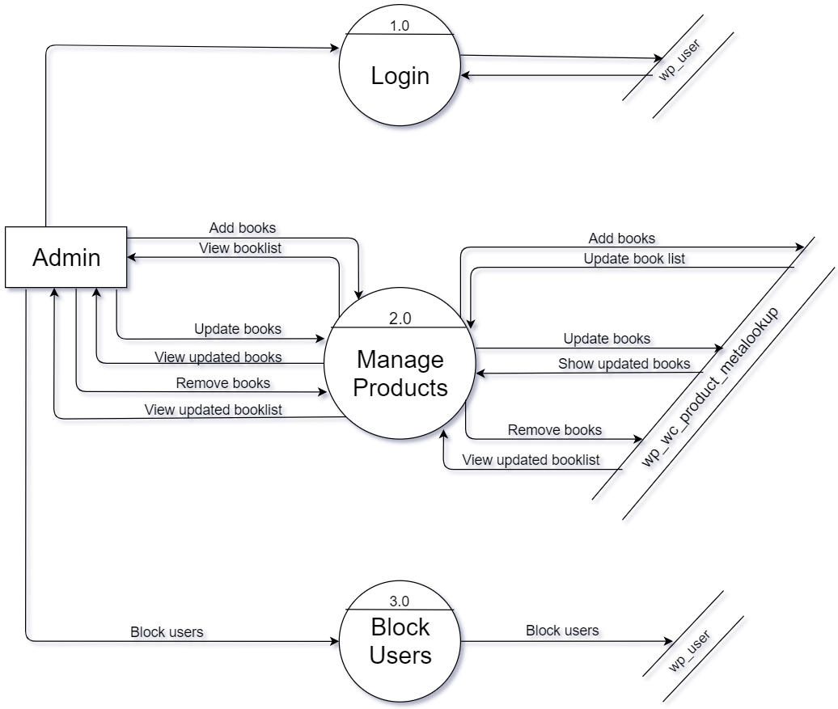
3.7.2 Data Flow Diagram for Admin(Level 1)

Slide 14
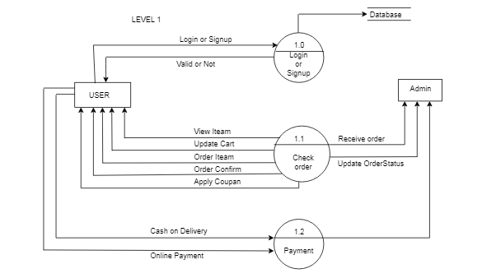
3.7.3 Data Flow Diagram for User(Level 1)

Slide 15
4. DATA DICTIONARY
4.1 Database Tables
wp_users
Field name | Data type | Size | Constraint | Reference | Description
user_ID | bigint | 20 | Primary Key | - | To get user Id
user_login | varchar | 60 | NOT NULL | - | To get user email for login
user_pass | varchar | 255 | NOT NULL | - | To get user password
user_nicename | varchar | 50 | NULL | - | User First or nickName
user_email | varchar | 100 | NULL | - | To get user email
user_url | varchar | 100 | NULL | - | url for user
user_registered | datetime | - | NOT NULL | - | User registration time
user_activation_key | varchar | 255 | NULL | - | For user activation
user_status | int | 11 | NOT NULL | - | For user status
display_name | varchar | 250 | NULL | - | For display user name

Slide 16
wp_sessions
Field Name | Data Type | Size | Constraint | Reference | Description
session_id | bigint | 20 | Primary Key | - | ID of session
session_key | char | 32 | NOT NULL | - | Key of session
session_value | longtext | 1000 | NOT NULL | - | Value of session
session_expiry | bigint | 20 | NOT NULL | - | expiry time of session
wp_ewd_otp_order_statuses
Field Name | Data Type | Size | Constraint | Reference | Description
order_Status | text | 100 | NOT NULL | - | For order status
order_Status_ID | mediumint | 9 | NOT NULL | - | For status id
order_Location | text | 100 | NOT NULL | - | For location of order
order_ID | mediumint | 9 | Primary key | - | Contain order id

Slide 17
wp_woocommerce_shipping_zone_locations
Field Name | Data type | Size | Constraint | Reference | Description
zone_id | bigint | 20 | Primary Key | - | For zone id
zone_name | varchar | 200 | NOT NULL | - | For zone name
zone_order | bigint | 20 | NOT NULL | - | For zone order
wp_woocommerce_order_items
Field Name | Data type | Size | Constraint | Reference | Description
order_item_id | bigint | 20 | Primary key | - | For item id
order_item_name | text | 100 | NOT NULL | - | For order item name
order_item_type | varchar | 200 | NOT NULL | - | Type of ordered item
order_ID | bigint | 20 | Foregin Key | wp_ewd_otp_order_statuses | Contain orderID

Slide 18
wp_comments
Field Name | Data Type | Size | Constraint | Reference | Description
comment_id | bigint | 20 | Primary Key | - | Comment ID
comment_post_id | bigint | 20 | NOT NULL | - | Post ID of Comment
comment_author | tinytext | 100 | NOT NULL | - | Author of Comment
comment_author_email | varchar | 100 | NOT NULL | - | Email of comment author
comment_author_url | varchar | 200 | NOT NULL | - | URL of comment author
comment_author_ip | varchar | 100 | NOT NULL | - | IP address of comment author
comment_date | datetime | - | NOT NULL | - | date of comment
comment_date_gmt | datetime | - | NOT NULL | - | date of comment in gmt
comment_content | text | 600 | NOT NULL | - | Content of comment
comment_karma | int | 11 | NOT NULL | - | Karma of comment
comment_approved | varchar | 20 | NOT NULL | - | Comment approval
comment_agent | varchar | 255 | NOT NULL | - | Agent of comment
comment_type | varchar | 20 | NOT NULL | - | Type of comment
comment_parent | bigint | 20 | NOT NULL | - | Parent of comment
user_id | bigint | 20 | Foreign Key | wp_users | ID of user

Slide 19
wp_woocommerce_payment_tokens
Field Name | Data Type | Size | Constraint | Reference | Description
token_id | bigint | 20 | Primary Key | - | ID
gateway_id | varchar | 200 | NOT NULL | - | gateway id
token | text | 100 | NULL | - | Token name
user_id | bigint | 20 | Foregin Key | wp_users | User ID
type | varchar | 20 | NULL | - | Token type
wp_failed_jobs
Field Name | Data Type | Size | Constraint | Reference | Description
id | bigint | 20 | Primary Key | - | Id
job | text | 100 | NOT NULL | - | Failed jobs
failed_at | datetime | - | NULL | - | Failed time

Slide 20
wp_woocommerce_payment_tokens
Field Name | Data Type | Size | Constraint | Reference | Description
token_id | bigint | 20 | Primary Key | - | ID of token
gateway_id | varchar | 200 | NOT NULL | - | ID of gateway
token | text | 600 | NOT NULL | - | Token
user_id | bigint | 20 | Foreign Key | wp_users | ID of user
type | varchar | 200 | NOT NULL | - | type of token
is_default | tinyint | 1 | NOT NULL | - | is default or not
wp_commentmeta
Field Name | Data type | Size | Constraint | Reference | Description
meta_id | bigint | 20 | Primary Key | - | For zone id
comment_id | varchar | 200 | NOT NULL | - | For zone name
meta_key | bigint | 20 | NULL | - | For zone order

Slide 21
wp_posts
Field Name | Data Type | Size | Constraint | Reference | Description
ID | bigint | 20 | Primary Key | - | ID of post
post_author | bigint | 20 | NOT NULL | - | Author of post
posst_date | datetime | - | NOT NULL | - | Date of post
post_date_gmt | datetime | - | NOT NULL | - | GMT Date of post
post_content | longtext | 1000 | NOT NULL | - | Content of post
post_title | text | 600 | NOT NULL | - | Title pf post
post_excerpt | text | 600 | NOT NULL | - | Excerpt of post
post_status | varchar | 20 | NOT NULL | - | Status of post
comment_status | varchar | 20 | NOT NULL | - | Comment status
ping_status | varchar | 20 | NOT NULL | - | Status of ping
post_password | varchar | 255 | NOT NULL | - | Password of post
post_name | varchar | 200 | NOT NULL | - | Name of post
post_modified | datetime | - | NOT NULL | - | Time of modification
post_modified_ gmt | datetime | - | NOT NULL | - | GMT Time of modification
post_content_ filtered | longtext | 1000 | NOT NULL | - | Filtered post content
post_prarent | bigint | 20 | NOT NULL | - | Parent of post
menu_order | int | 11 | NOT NULL | - | Order of menu
post_type | varchar | 20 | NOT NULL | - | Type of Post
post_mime_type | varchar | 100 | NOT NULL | - | MIME type of post
comment_count | bigint | 20 | NOT NULL | - | Comment count

Slide 22
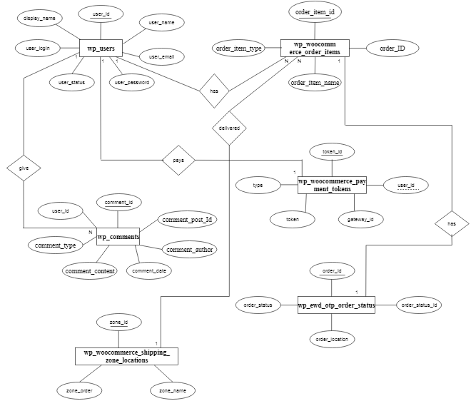
5.2 ER Diagram

Slide 23
6. SCREENSHOTS
6.1 Admin Page
Admin of the system can login through this page.
Admin panel is displayed once admin login through this.
Admin manages the entire site through the admin panel.

Slide 24
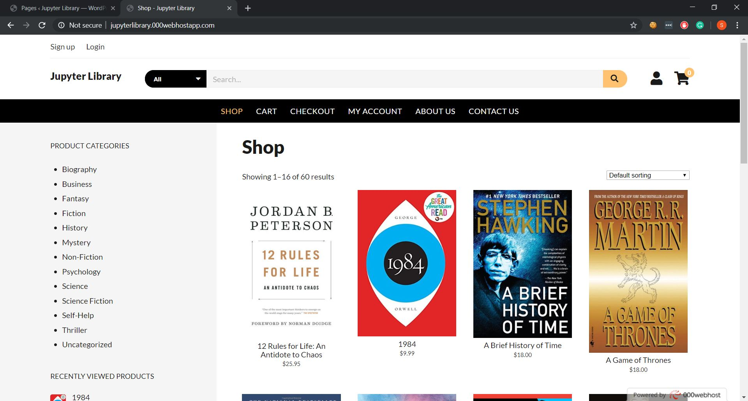
6.2 Store Page
Books available on the store are displayed here.
User can search for books and filter by category.
User can add books to cart and checkout as well.

Slide 25
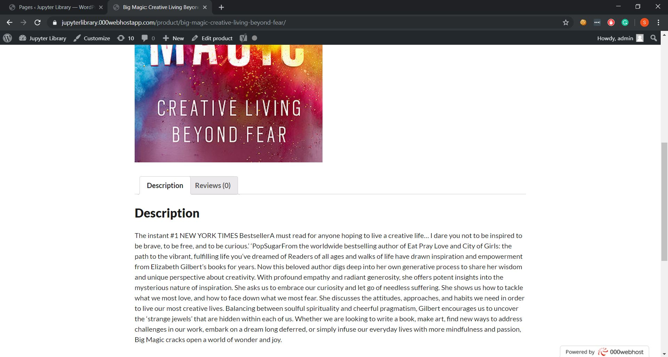
6.3 Book Detail Page
Details of the book can be seen here.
Title, Description, Cover Image and reviews are displayed.
User can comment and write reviews for the products.

Slide 26
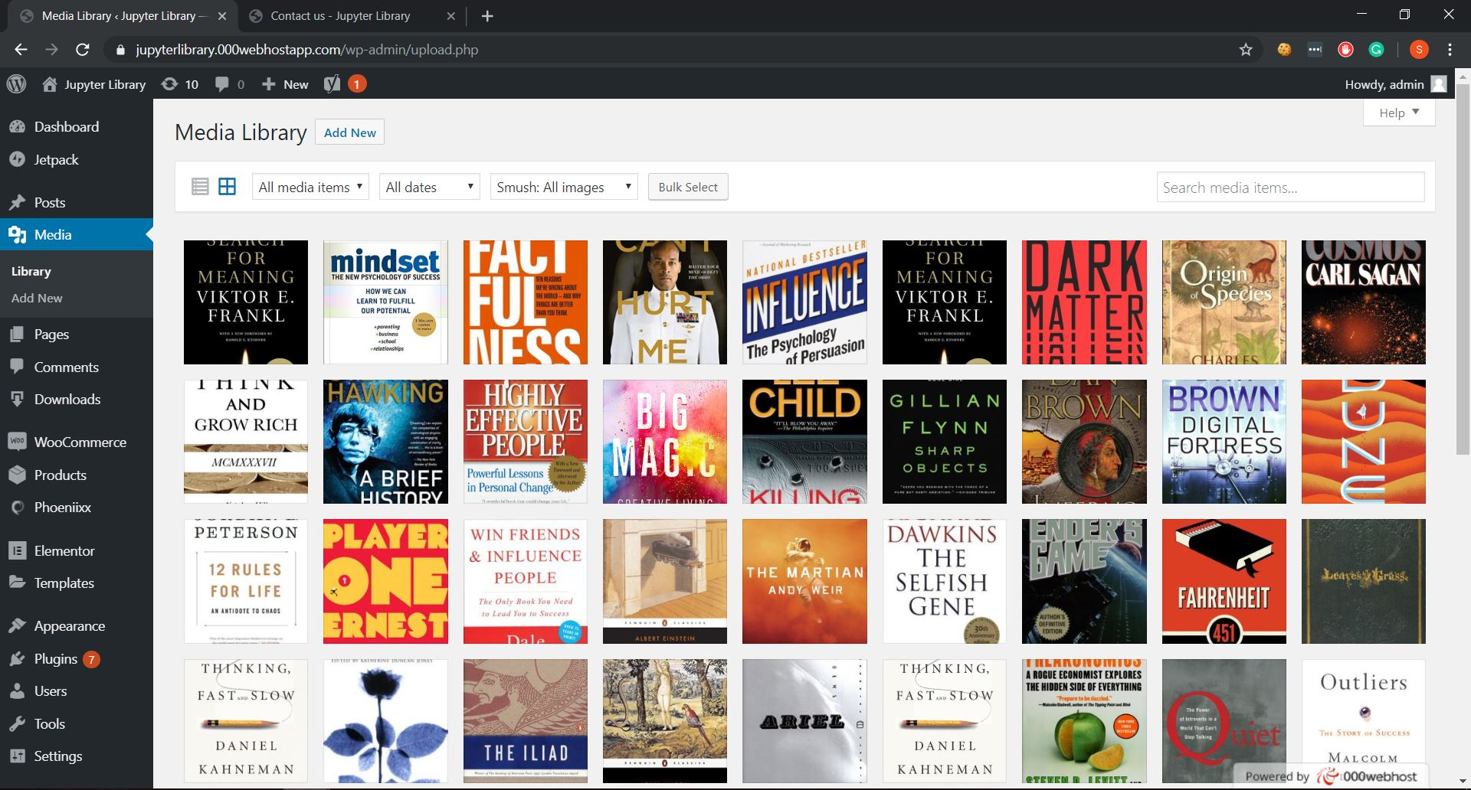
6.4 Media Library
Media of website is seen here.
All book cover images are displayed here.

Slide 27
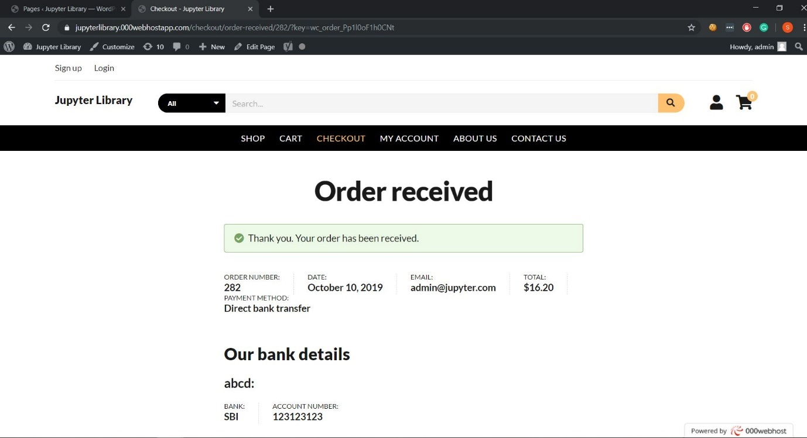
6.5 Order Confirmation
User can place order and checkout.
Order confirmation is displayed.

Slide 28
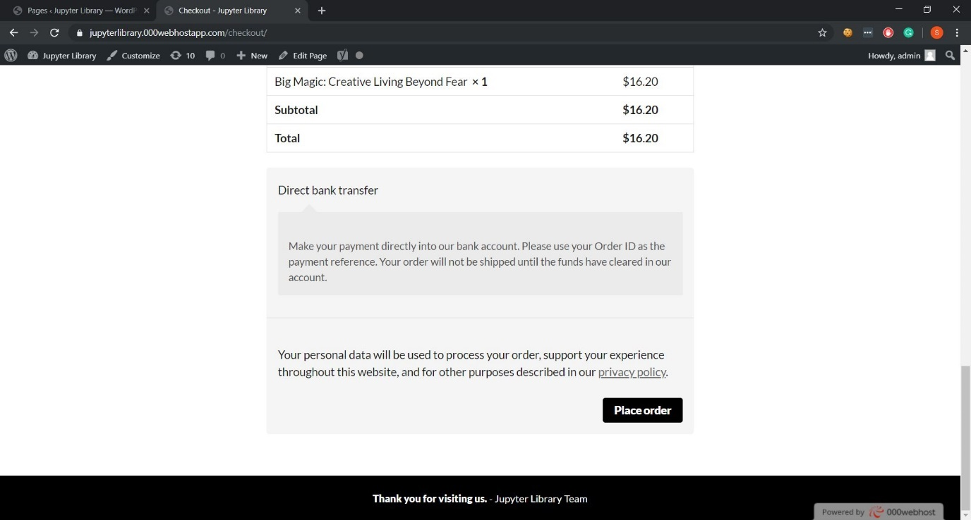
6.6 Order Detail
User can place order and checkout.
Order confirmation is displayed.

Slide 29
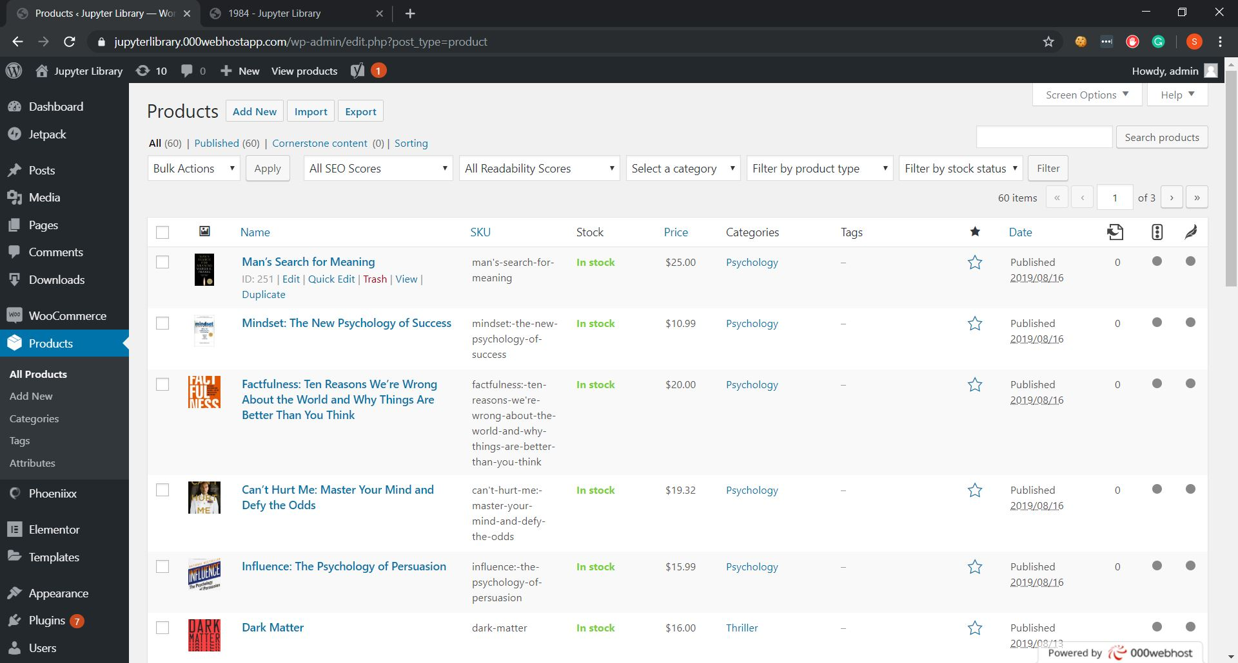
6.7 Products
This is admin page for products.
Admin can manage products from here.
Admin can add, update and delete products from this page.

Slide 30
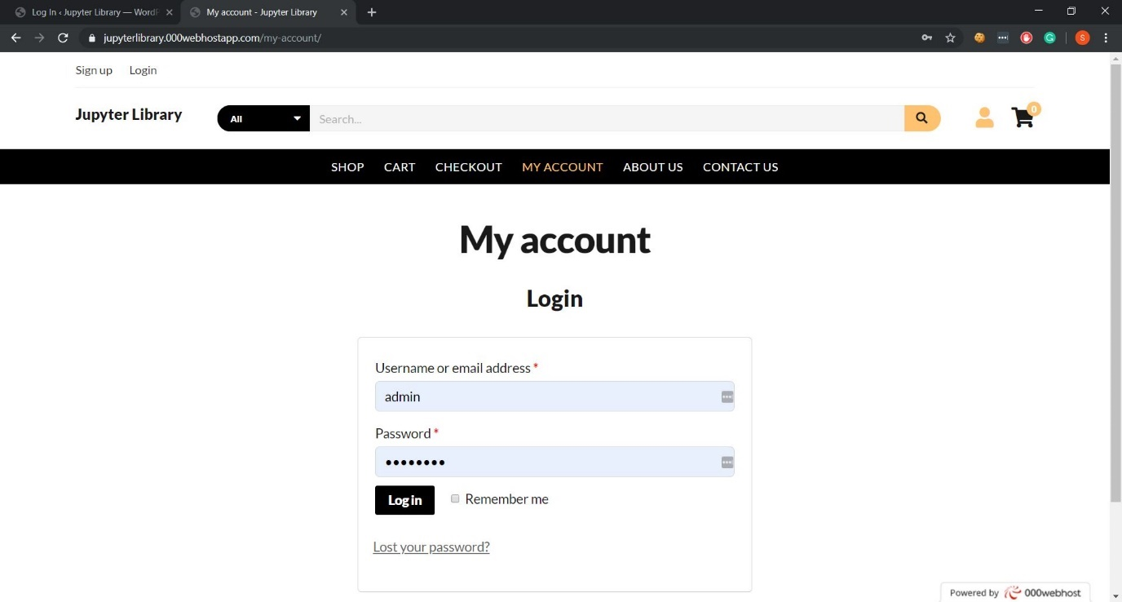
6.8 User Login
User can login from this page.

Slide 31
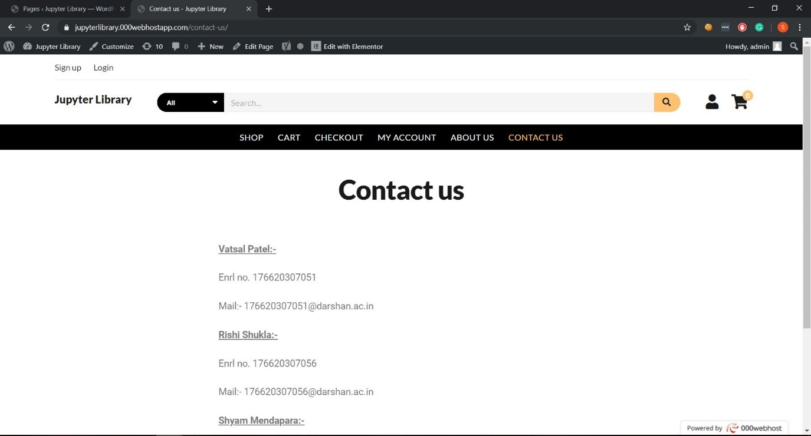
6.9 Contact Page
Comments can be seen here.
Admin can approve or delete comments.

Slide 32
7. Conclusion
After completion of this project, users can order fast food of all types at their home quickly and easily. This will provide you with all the information about ingredients of food with different buying options

Slide 33
THANK YOU
AND
ANY QUESTION?

